Slide 1
RNN

Slide 2
Introduction to RNNs
Recurrent Neural Networks (RNNs) are a class of neural networks designed specifically for processing sequences of data.
Unlike traditional feedforward neural networks, which assume that inputs are independent of each other, RNNs have a built-in memory mechanism that allows them to retain information from previous inputs in the sequence.
This is achieved through recurrent connections, where the output from previous time steps is fed back into the network along with the current input.

Slide 3
Key Characteristics
Sequential Data Handling: RNNs are adept at handling sequential data where the order of inputs is crucial.
Memory Mechanism: They have the ability to remember previous inputs due to their recurrent connections, making them suitable for tasks that require context or temporal dependencies.

Slide 4
Basic Architecture
Hidden State (h_t): At each time step t, the network maintains a hidden state ht​, which is a summary of the information processed up to that point.
Recurrent Connection: The hidden state at time step t is computed using the hidden state from the previous time step ht−1​ and the current input xt​.

Slide 5
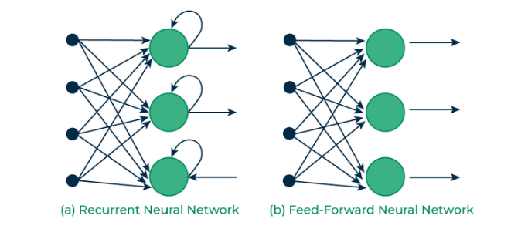

Slide 6
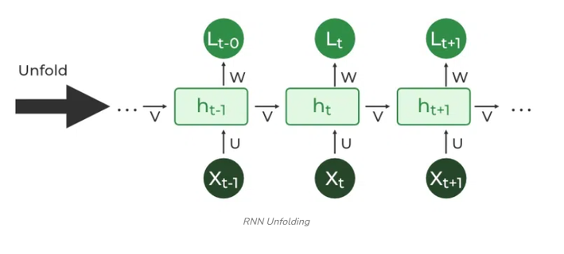

Slide 7
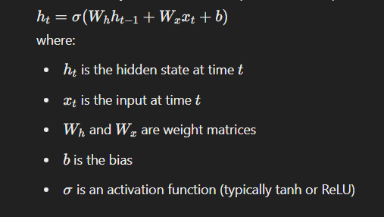
Mathematically, the hidden state update can be represented as:

Slide 8
Applications of RNN:
Language Modeling
Time Series Prediction
Machine Translation
Speech Recognition

Slide 9
1.Language Modeling
Task: Predict the next word in a sentence.
Example: Given a sequence of words, an RNN can predict the probability distribution of the next word. This is fundamental for applications like text generation and autocomplete.
Details: Language models can be trained on large corpora of text to understand the statistical properties of a language. They capture the context and dependencies between words, enabling them to generate coherent and contextually relevant sentences.

Slide 10
2. Time Series Prediction
Task: Forecast future values based on past observations.
Example: Predicting stock prices, weather forecasting, and demand forecasting.
Details: Time series data consists of observations collected at successive time points. RNNs can model the temporal dependencies and trends in the data to make accurate predictions. They can also handle varying lengths of input sequences, making them versatile for different time series problems.

Slide 11
3. Machine Translation
Task: Translate text from one language to another.
Example: Converting a sentence from English to French.
Details: In machine translation, an RNN can be used to encode the source sentence into a fixed-length context vector, which is then decoded into the target sentence. This encoder-decoder architecture allows the model to handle variable-length input and output sequences, capturing the nuances of both languages.

Slide 12
4. Speech Recognition
Task: Convert spoken language into written text.
Example: Transcribing an audio recording of a lecture.
Details: Speech recognition systems use RNNs to process audio signals, which are inherently sequential. The model learns to map sequences of audio features to sequences of phonemes or words. This involves understanding the temporal structure of speech, including pauses, intonation, and context.

Slide 13
Deep Dive into Applications:
1. Language Modeling
Implementation: Start with a dataset like the Penn Treebank or Wikipedia text corpus. Tokenize the text into words or subwords, and then feed sequences of these tokens into the RNN. Use the hidden states to predict the next token in the sequence.
Evaluation: Use metrics like perplexity, which measures how well the probability distribution predicted by the model matches the actual distribution of words in the corpus.

Slide 14
2. Time Series Prediction
Implementation: Use a dataset like historical stock prices or weather data. Normalize the data and create sequences of past observations as inputs. The RNN will learn to predict the next value in the sequence.
Evaluation: Use metrics like Mean Absolute Error (MAE) or Root Mean Squared Error (RMSE) to evaluate the prediction accuracy.

Slide 15
3. Machine Translation
Implementation: Use parallel corpora like the Europarl dataset. Train an encoder-decoder RNN where the encoder processes the source sentence and the decoder generates the target sentence.
Evaluation: Use metrics like BLEU (Bilingual Evaluation Understudy) score to evaluate the quality of the translations.

Slide 16
4. Speech Recognition
Implementation: Use datasets like LibriSpeech. Extract features from the audio signals (e.g., Mel-Frequency Cepstral Coefficients - MFCCs) and feed them into the RNN. The model learns to map these features to text sequences.
Evaluation: Use metrics like Word Error Rate (WER) to evaluate the transcription accuracy.

Slide 17
The Structure of RNNs
Recurrent Neural Networks (RNNs) have a unique architecture compared to traditional feedforward neural networks.
The key feature of an RNN is its ability to maintain a memory of previous inputs through its recurrent connections.
This allows RNNs to capture temporal dependencies and context in sequences of data.

Slide 18
Key Components
Input Layer: Receives the input data at each time step.
Recurrent Layer: Processes the input along with the hidden state from the previous time step.
Output Layer: Produces the output for the current time step.

Slide 19
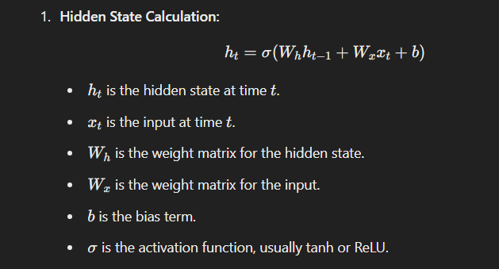
Mathematical Foundation
RNNs use the following equations to process sequences:

Slide 20
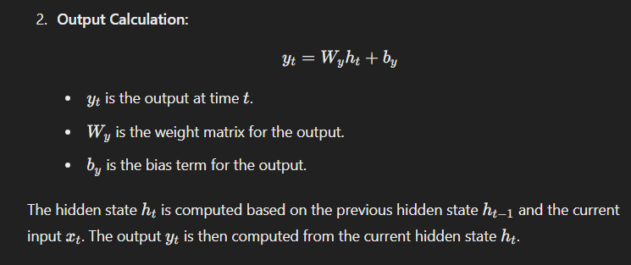

Slide 21
Backpropagation Through Time (BPTT)
Training RNNs involves adjusting the weights based on the error gradients.
This process is known as Backpropagation Through Time (BPTT).
Unrolling the Network:
The RNN is "unrolled" or unfolded through time steps for a fixed number of steps. This allows us to apply backpropagation as in a feedforward network.
Error Calculation:
Compute the loss (e.g., cross-entropy loss) based on the difference between the predicted output and the true target.
Gradient Computation:
Calculate gradients of the loss with respect to the weights using backpropagation. The gradients are propagated backward through the unfolded network.
Weight Update:
Update the weights using an optimization algorithm like Gradient Descent or Adam.

Slide 22
Challenges
Vanishing Gradient Problem:
During training, gradients can become very small, leading to difficulties in learning long-term dependencies.
Exploding Gradient Problem:
Conversely, gradients can become very large, leading to unstable training and exploding weights.

Slide 23
Types of RNNs
Vanilla RNN
Long Short-Term Memory (LSTM)
Gated Recurrent Unit (GRU)

Slide 24
1. Vanilla RNN:
Description: The basic RNN architecture. It consists of a simple recurrent layer where the output at each time step is a function of the previous hidden state and the current input.
2. Long Short-Term Memory (LSTM):
Description: An advanced RNN architecture designed to address the vanishing gradient problem. LSTMs use gates to control the flow of information, enabling them to learn long-term dependencies more effectively.
Key Components:
Forget Gate: Determines which information to discard from the cell state.
Input Gate: Determines which new information to add to the cell state.
Output Gate: Determines what part of the cell state to output.

Slide 25
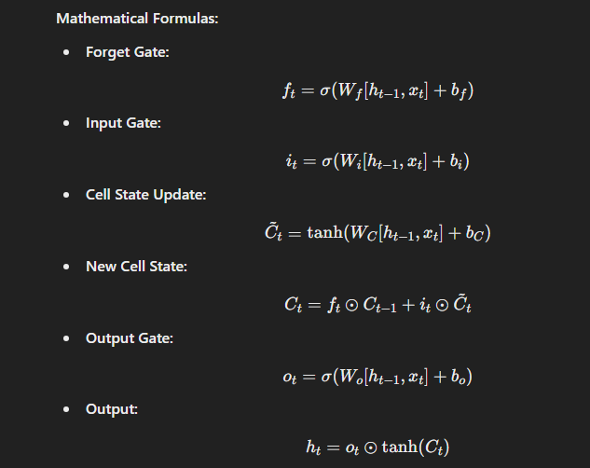

Slide 26
Gated Recurrent Unit (GRU)
Description: A simplified version of LSTMs that combines the forget and input gates into a single update gate, reducing the number of parameters and computational complexity.
Key Components:
Update Gate: Controls how much of the past information needs to be passed to the future.
Reset Gate: Determines how much of the past information to forget

Slide 27
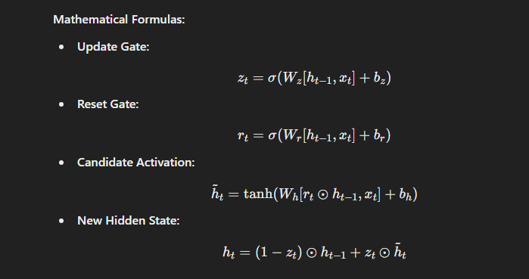

Slide 28
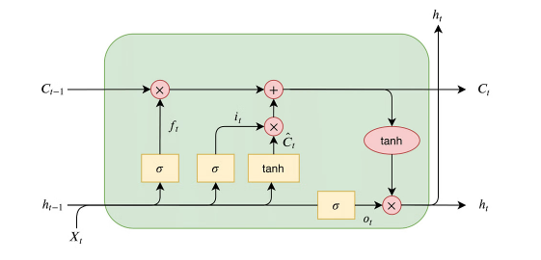
Long Short Term Memory (LSTM)

Slide 29
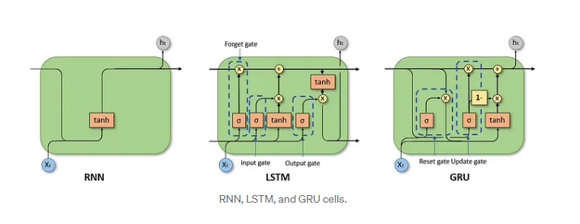

Slide 30
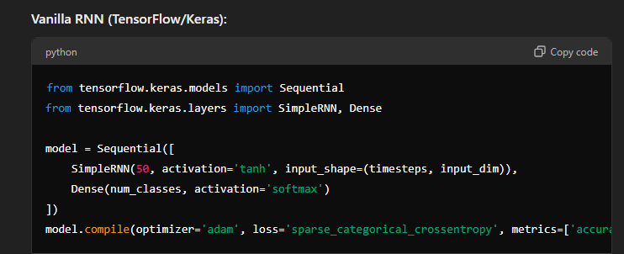
Example Code

Slide 31
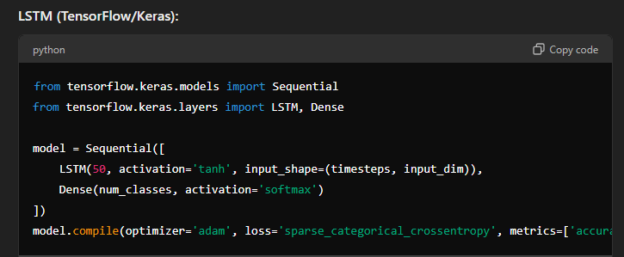

Slide 32
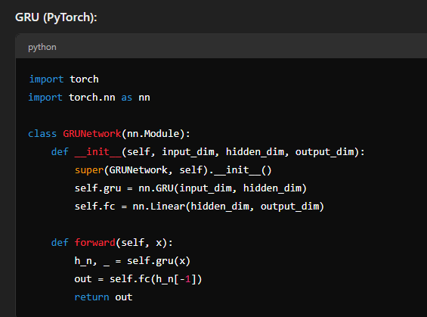

Slide 33
6. Implementing RNNs
Libraries: Use frameworks like TensorFlow or PyTorch to implement RNNs.
Example Code: Provide sample code for a basic RNN, LSTM, and GRU.
7. Practical Applications
Use Cases: Go through practical examples such as text generation, sentiment analysis, and sequence prediction.
Hands-on Projects: Assign projects where students can implement and train RNNs on real datasets.

Slide 34
10~minute break

